Slide 1
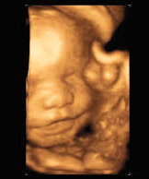
Hazard Community and Technical College (HCTC)
Diagnostic Medical Sonography Program
Pre-Admission Conference

Slide 2

MS Teams Virtual Meeting Rules
Please mute all microphones. It cuts down on the background noise for everyone
You will have opportunities to ask questions throughout the presentation.
Turn off your video camera. This decreases the band width and will make the presentation run smoother.
Turn on the chat box.
You MUST type in your name and student e-mail address within the chat box. It is how we take attendance for this conference.
This meeting is being recorded.

Slide 3
About the Diagnostic Medical Sonography Program
This is an eighteen-month program leading to the Associate in Applied Science degree. The program is 4 semesters including a summer clinical.
All general education and support course work must be completed with a grade of “C” or better prior to enrolling in the first DMS course.
The curriculum is comprised of general education and sonography courses. Various facilities are utilized for clinical experiences.
Enrollment in this program is limited; therefore, a selective admissions process utilizing a point index system is followed.

Slide 4
Program Format
The lecture (didactic) component of the Diagnostic Medical Sonography courses is taught in person and utilizing blackboard.
The laboratory component of the Sonography courses is in person and is located the Allied Health Center of Hazard Community and Technical College.
The clinical component of the Sonography Program utilizes clinical sites throughout Kentucky and a couple sites in Virginia.

Slide 5
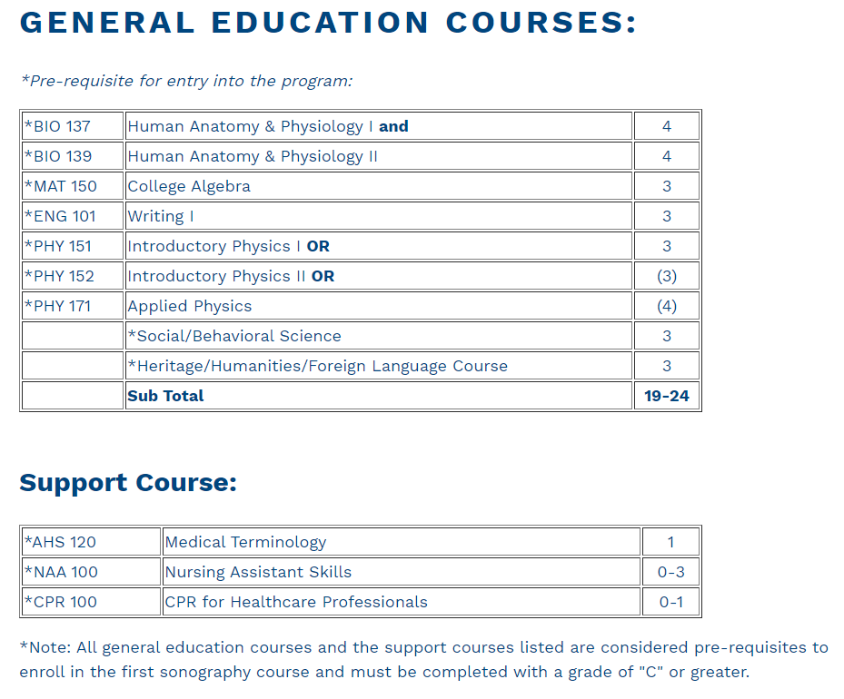
Program Curriculum

Slide 6
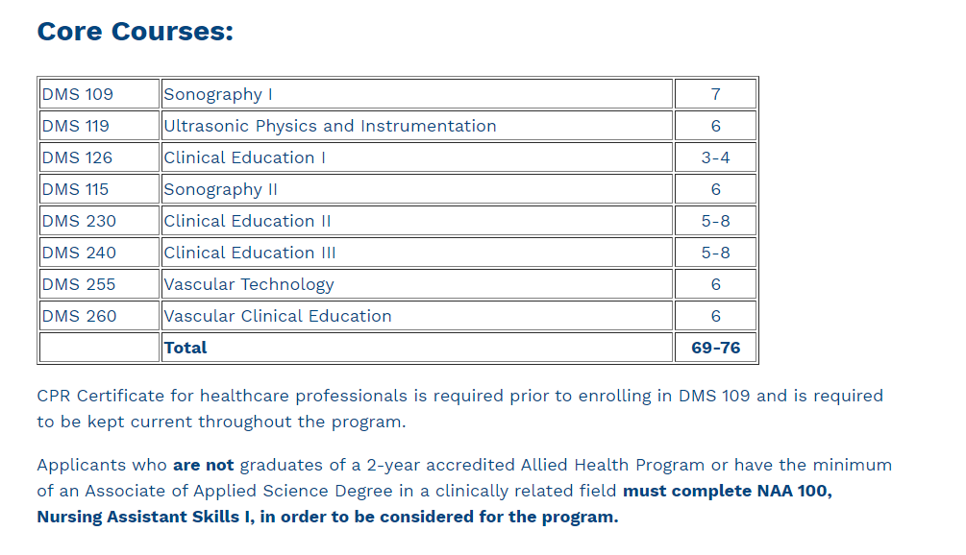

Slide 7

Expenses
Tuition and Fees
Transportation to and from the various clinical sites
Professional Liability Insurance
Textbooks (Including Trajecsys-clinical reporting tool).
Uniforms/Clinical Dress
Students will be required to complete criminal background checks and drug screenings in order to enter the health care facilities for clinical. Students are responsible for the cost. Based on the results, the facility has the right to deny students admission to the clinical site.

Slide 8
APPLICATION PROCESS
To be considered for admission to the Diagnostic Medical Sonography Program, the following credentials must be on file in the HCTC Registrar’s-Records Office by March 15, 2026.
Application for admission to the college;
Official transcripts of all postsecondary education or training;
ACT composite score report;
Documentation denoting completion of NAA 100 with a grade of "C" or better or a graduate of a two-year accredited Allied Heath Program;
Documentation denoting completion of each Diagnostic Medical Sonography pre-requisite courses with a grade of "C" or better; and
Pre-admission conference with the Director or designee is required prior to admission to the Diagnostic Medical Sonography Program. The next class admission will be Fall 2026.
You are responsible for verifying that your file is complete!

Slide 9
Selective Admission Criteria Form
Preference may be given to:
Applicants with an ACT composite score of 21 or above;
Applicants who have a cumulative GPA of 2.5 or better (4.0) in 10 hours of college credit applicable to the Diagnostic Medical Sonography Program; and
Applicants who have graduated or are in their final semester of a two-year accredited Allied Health Program or have the minimum of an Associate of Applied Science Degree in clinically related field.

Slide 10
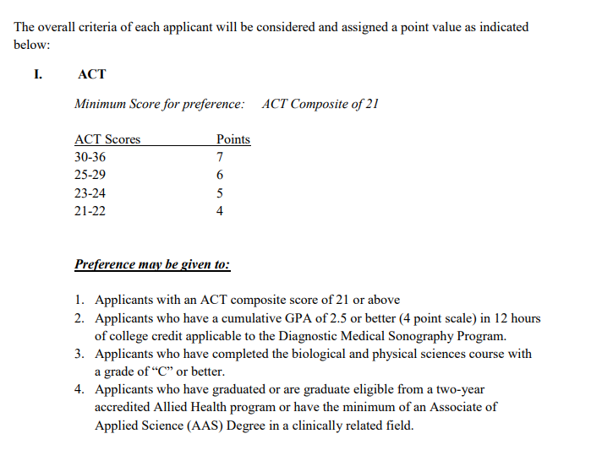

Slide 11
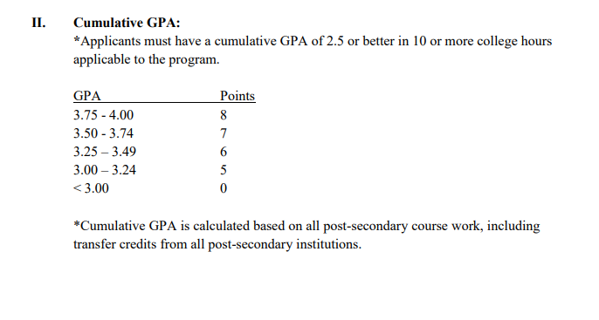

Slide 12
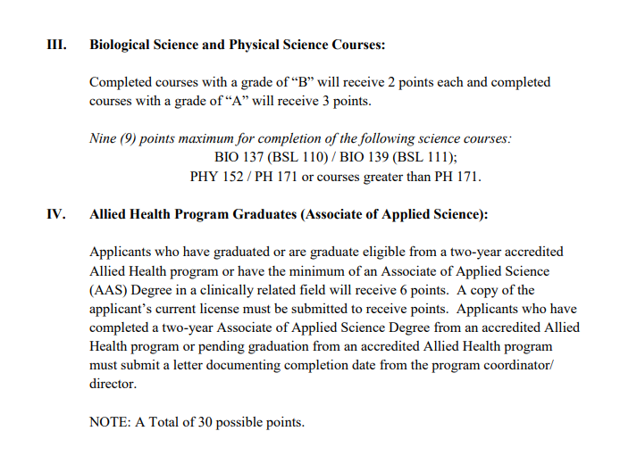

Slide 13

Selective Admissions Information
The following documents must be in your Selective Admissions File for it to be complete:
Current application for admission to a KCTCS institution.
Official transcripts of all post-secondary education, excluding KCTCS institutions.
Post-Secondary Education Transcripts – Registrar’s-Records Office
Official transcripts cannot be hand delivered. We recommend using a digital credential service,
such as: www.parchment.com or www.getmytranscript.com.
ACT National Exam composite score
Proof of attendance at a Diagnostic Medical Sonography Program Pre-admission Conference.
Only complete Selective Admissions files will be considered for admission to the Diagnostic Medical Sonography Program.

Slide 14
Diagnostic Medical Sonography Program Application
You must complete the program application.
Link to electronic application:
Deadline for submission of materials is March 15, 2026.
REMEMBER, it is your responsibility to ensure your Diagnostic Medical Sonography Selective Admissions File is complete.

Slide 15
Submission of Documents
  Submit documents to the HCTC Registrar’s - Records Office
    -Libby Peters – Libby.Peters@kctcs.edu or call 487-3087
    Records Office for transcripts
    -Scott Gross – Scott.Gross@kctcs.edu or call 487-3528
  Admissions
    -April Baker – abaker0275@kctcs.edu- DMS program application
  The student is responsible for assuring their file is complete prior to the admissions deadline. If your file is not complete by the designated deadline of March 15 you are unable to be considered as an applicant for the Diagnostic Medical Sonography Program.

Slide 16
Diagnostic Medical Sonography Technical Standards
Diagnostic Medical Sonography involves the provision of direct care for individuals and is characterized by the application of verified knowledge in the skillful performance of Diagnostic Medical Sonography technical functions.
Therefore, all applicants should possess:
Sufficient visual acuity for the observation necessary for patient assessment and care.
Sufficient auditory perception to receive verbal communication from patients and members of the health team and to assess health needs of people through the use of monitoring devices (e.g., cardiac monitors, biomedical equipment, fire alarms, etc.).
Sufficient gross and fine motor coordination to respond promptly and to implement the skills, including the manipulation of equipment, positioning and lifting patients required in meeting health needs related to Diagnostic Medical Sonography.
Sufficient verbal and non-verbal communication skills (speech, reading, and writing), such as are needed in classroom and clinical settings to interact with patients and professional personnel.
Sufficient intellectual and emotional functions to plan and implement care for individuals.

Slide 17

Employment Outlook
According to the National Labor Statistics in Washington, D.C., the job market for Diagnostic Medical Sonography Overall employment of diagnostic medical sonographers and cardiovascular technologists and technicians is projected to grow 12 percent from 2019 to 2029, much faster than the average for all occupations. As the large baby-boom population ages, the need to diagnose medical conditions—such as blood clots and heart disease—will likely increase. Imaging technology is a tool used in making these diagnoses. Moreover, there is a demand for the upcoming graduating class, as well as continued phone inquiries on a monthly basis.
https://www.bls.gov/oes/current/oes292032.htm

Slide 18
Program Accreditation Status
The Hazard Community and Technical College Diagnostic Medical Sonography Program is accredited by the Commission on Accreditation of Allied Health Education Programs (CAAHEP), 9355- 113th ST. N. #7709, Seminole, FL 33775, Phone: (727) 210-2350; Fax: (727) 210-2354; E-mail: mail@caahep.org; Web: www.caahep.org.

Slide 19
Notice of Nondiscrimination
The Kentucky Community and Technical College System is an equal educational and employment opportunity institution and does not discriminate on the basis of; race, religion, color, sex, national origin, age, disability, family medical history, or genetic information. Further, we vigilantly prevent discrimination based on sexual orientation, parental status, marital status, political affiliation, military service, or any other non-merit based factor.

Slide 20

Questions
Thank you for your interest in the
Diagnostic Medical Sonography Program!
Please contact Sarah Rios, Program Coordinator
606-487-3572 or srios0015@kctcs.edu

